Slide 1
Network and Computer Security
Chapter 3 – Network and communication security
Prof. dr. ir. Eli De Poorter
Vakgroep Informatietechnologie – IBCN
© Eli De Poorter

Slide 2
Until now
Until now: basic concepts
  Symmetric encryption
  Asymmetric encryption
  Hash functions
  Message authentication codes
From now
  Applying these concepts to design security protocols for networked devices
    Secure configuration of devices
    Exchanging keys
    Secure networking protocols
    Firewalls
p. <number>

Slide 3
Overview
Network model
Secure configuration of devices
Exchanging keys
Secure networking protocols
Firewalls

Slide 4
Network architecture
possible intruder (prevention: see chapter 5)
possible intruder
access
point
router
router
laptop
server
router
router
Appl
Appl
Transp
Transp
Netw
Netw
Netw
Netw
Netw
Netw
Data
Data
Data
Data
Data
Data
Data
Phys
Phys
Phys
Phys
Phys
Phys
Phys
wireless
p. <number>

Slide 5

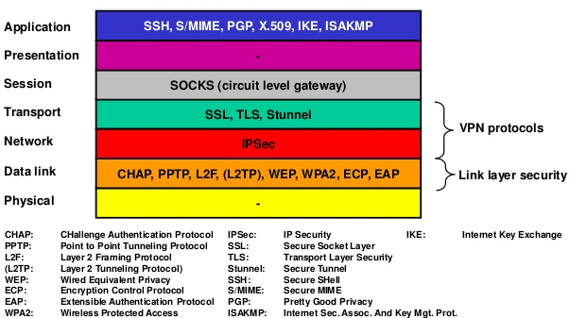
Often taken together as single application layer
Focus of chapter 5: system and software security
However, we already include SSH in this chapter, since it is used for secure configuration of the network
Notes:
SSH is an application layer security protocol. However, it includes a “transport layer protocol” component which runs on top of the OSI transport layer, acting as a secure connection between other OSI application layer protocols (such as HTTP) and the actual OSI transport layer. Due to the confusingly named RFC 4253, SSH is often depicted as a transport layer protocol, which it is not.
More information can be found in:
RFC 4253 Transport Layer Protocol
RFC 4251 Application layer protocol

Slide 6
Overview
Network model
Secure configuration of devices
  SSH (Secure Shell)
Exchanging keys
Secure networking protocols
Firewalls

Slide 7
SSH
access
point
router
router
laptop
server
router
router
Appl
SSH
Appl
Transp
Transp
Netw
Netw
Netw
Netw
Netw
Netw
Data
Data
Data
Data
Data
Data
Data
Phys
Phys
Phys
Phys
Phys
Phys
Phys
wireless
p. <number>
Notes:
Note that many routers and even switches also include SSH management functionality (e.g. they include some application layer functionality).

Slide 8
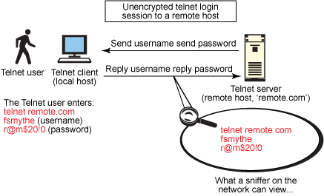
SSH
Telnet for server management: inherently unsafe
Notes:
Secure Shell (SSH) was intended and designed for protection when remotely accessing another host over the network. The figures show how easily a telnet session can be casually viewed by anyone on the network using a network-sniffing application such as Wireshark. When using an unsecured, "clear text" protocol such as telnet, anyone on the network can pilfer your passwords and other sensitive information. The figure shows user fsmythe logging in to a remote host through a telnet connection. He enters his user name fsmythe and password r@m$20!0, which are both then viewable by any other user on the same network as our hapless and unsuspecting telnet user.

Slide 9
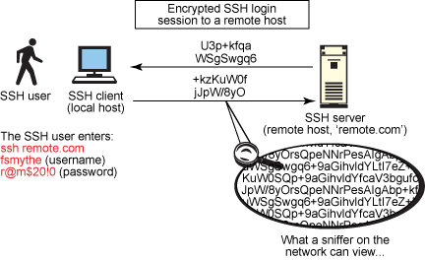
SSH
Server management using SSH
Notes:
Secure Shell (SSH) was intended and designed to offer protection when remotely accessing another host over the network and was designed to be relatively simple and inexpensive to implement. The initial version, SSH1, focused on providing a secure remote logon facility to replace Telnet and other remote logon schemes that provided no security. A new version, SSH2, provides a standardized definition of SSH and improves on SSH1 in numerous ways.
This slide provides an overview of a typical SSH session and shows how the encrypted protocol cannot be viewed by any other user on the same network segment. Every major Linux and UNIX distribution now comes with a version of the SSH packages installed by default—typically, the open source OpenSSH packages—so there is little need to download and compile from source. If you're not on a Linux or UNIX platform, a plethora of open source and freeware SSH-based tools are available that enjoy a large following for support and practice, such as PuTTY, SuperPuTTY, MobaXTerm, WinSCP, FileZilla, TTSSH, Cygwin (POSIX software installed on top the Windows operating system) and the windows port of OpenSSH. These tools offer a UNIX- or Linux-like shell interface on a Windows platform.

Slide 10
SSH
SSH (Secure SHell)
  Features
    Protocol for secure remote login
    Also supports tunneling (VPN use)
      TCP tunnelled through SSH connection
    Can also be use to transfer files using associated protocols SCP (Secure CoPy) or SFTP (SSH File Transfer Protocol)
    X-session forwarding and port forwarding
  Originally developed by SSH Communications Security Corp., Finland
  Many distributions available:
    Freeware (www.openssh.org, putty, etc.)
    Commercial versions
  IETF standard (RFCs 4250-4256)
p. <number>
Notes:
SSH provides a general client-server capability and encrypts the network exchange. In addition, it can be used to secure such network functions as file transfer (Secure Copy (SCP) and Secure File Transfer Protocol (SFTP)), X session forwarding, and port forwarding to increase the security of other insecure protocols. Various types of encryption are available, ranging from 512-bit encryption to as high as 32768 bits. It includes several encryption methods such as Blowfish, Triple DES, CAST-128, Advanced Encryption Scheme (AES), and ARCFOUR. Higher-bit encryption configurations come at a cost of greater network bandwidth use.
SSH2 is documented as a proposed standard in RFCs 4250 through 4256.

Slide 11
SSH
Security features
  Uses well-established algorithms for encryption, data-integrity, key exchange, and public key management
  Encryption with at least 128 bit keys
  Security algorithm negotiation
    Basic protocol needn’t be changed when switching to other, newer algorithms
p. <number>

Slide 12
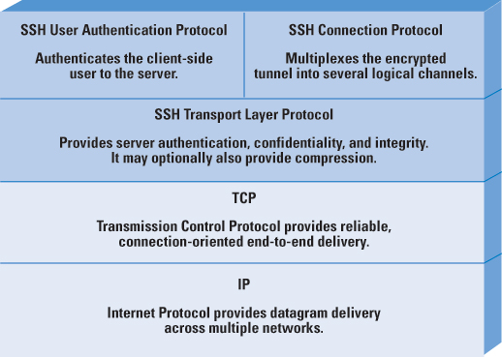
SSH: architecture
SSH transport layer protocol
  Server authentication, confidentiality, and integrity
  Compression (optional)
  On top of reliable transport layer (e.g. TCP)
SSH user authentication protocol
  Client authentication
  On top of SSH transport layer
SSH connection protocol
  Multiplexes secure tunnel provided by SSH transport layer and user authentication layer into several logical channels
  Logical channels can be used for various purposes
p. <number>
Notes:
IETF RFCs 4251 through 4256 define SSH as the "Secure Shell Protocol for remote login and other secure network services over an insecure network." The shell consists of three main elements.
Transport Layer Protocol: This protocol accommodates server authentication, data confidentiality, and data integrity with perfect forward privacy (that is, if a key is compromised during one session, the knowledge does not affect the security of earlier sessions). The transport layer is responsible for key exchange and server authentication. It sets up encryption, integrity verification, and (optionally) compression and exposes to the upper layer an API for sending and receiving plain text packets. This layer is typically run over a TCP/IP connection but can also be used on top of any other dependable data stream.
User Authentication Protocol: This protocol authenticates the client to the server and runs over the transport layer. Common authentication methods include password, public key, keyboard-interactive, GSSAPI, SecureID, and PAM.
Connection Protocol: This protocol multiplexes the encrypted tunnel to numerous logical channels, running over the User Authentication Protocol. The connection layer defines channels, global requests, and the channel requests through which SSH services are provided. A single SSH connection can host multiple channels concurrently, each transferring data in both directions. Channel requests relay information such as the exit code of a server-side process. The SSH client initiates a request to forward a server-side port.
The “SSH transport layer protocol” is not to be confused with the “OSI transport layer”: it is part of the SSH protocol and runs on top of the layer 4 OSI network layer (i.e.: the actual transport layer of the network stack, e.g. TCP or any other reliable transport layer protocol).

Slide 13
SSH: transport layer protocol
Features
  Server authentication, confidentiality, and integrity
  Compression (optional)
  On top of reliable transport layer (e.g. TCP)
p. <number>
Notes:
Server authentication occurs at the transport layer protocol, based on the server possessing a public-private key pair. A server may have multiple host keys using multiple different asymmetric encryption algorithms. Multiple hosts may share the same host key. In any case, the server host key is used during key exchange to authenticate the identity of the host. For this authentication to be possible, the client must have presumptive knowledge of the server public host key. RFC 4251 dictates two alternative trust models that can be used:
The client has a local database that associates each host name (as typed by the user) with the corresponding public host key. This method requires no centrally administered infrastructure and no third-party coordination. The downside is that the database of name-to-key associations may become burdensome to maintain.
The host name-to-key association is certified by a trusted Certification Authority (CA) (see later). The client knows only the CA root key and can verify the validity of all host keys certified by accepted CAs. This alternative eases the maintenance problem, because ideally only a single CA key needs to be securely stored on the client. On the other hand, each host key must be appropriately certified by a central authority before authorization is possible.

Slide 14
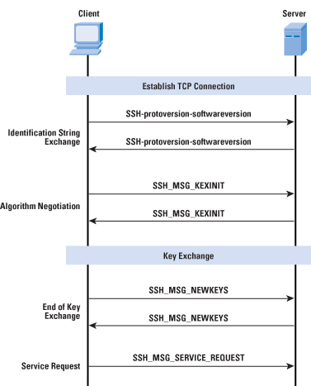
SSH: transport layer protocol
  Security algorithm negotiation
p. <number>
Notes:
SSH includes negotiation algorithms to determine suitable encryption algorithms. The SSH Transport Layer packet exchange consists of a sequence of steps, illustrated above. First, the client establishes a TCP connection to the server with the TCP protocol (which is not part of the Transport Layer Protocol). When the connection is established, the client and server exchange the following data packets (using the data field of a TCP segment).
Identification string exchange
The first step, the identification string exchange, begins with the client sending a packet with an identification string of the form: ”SSH-protoversion-softwareversion SP comments CR LF”, where SP, CR, and LF are space character, carriage return, and line feed, respectively. An example of a valid string is SSH-2.0-billsSSH_3.6.3q3<CR><LF> (SSH protocol version 2, software version billsSSH_3.6.3q3). The server responds with its own identification string.
Algorithm negotiation
Next comes algorithm negotiation. Each side sends an SSH_MSG_KEXINIT containing lists of supported algorithms in the order of preference to the sender. Each type of cryptographic algorithm has one list. The algorithms include key exchange, encryption, MAC algorithm, and compression algorithm. For each category, the algorithm chosen is the first algorithm on the client’s list that is also supported by the server.
Key exchange
The next step is key exchange. The specification allows for alternative methods of key exchange, but at present only two versions of Diffie–Hellman (assymetrical encryption) key exchange are specified. Both versions are defined in RFC 2409 and require only one packet in each direction. The end of key exchange is signaled by the exchange of SSH_MSG_NEWKEYS packets. At this point, both sides may start using the generated keys.
Service request
The final step is service request. The client sends an SSH_MSG_SERVICE_REQUEST packet to request either the User Authentication or the Connection Protocol. Subsequent to this request, all data is exchanged as the payload of an SSH Transport Layer packet, protected by encryption and MAC.

Slide 15
SSH: transport layer protocol
Binary packet protocol
packet length (4 bytes)
encrypted
+
authenticated
padding length (1 byte)
payload
optionally
compressed
random padding (4-255 bytes)
MAC
p. <number>
Notes:
Each data packet is in the following format:
Packet length: Packet length is the length of the packet in bytes, not including the packet length and Message Authentication Code (MAC) fields.
Padding length: Padding length is the length of the random padding field.
Payload: Payload constitutes the useful contents of the packet. Prior to algorithm negotiation, this field is uncompressed. If compression is negotiated, then in subsequent packets this field is compressed. Maximal (uncompressed) size is (at least) 32768 bytes (longer packets may be supported, depending on the implementation).
Random padding: After an encryption algorithm is negotiated, this field is added. It contains random bytes of padding so that that total length of the packet (excluding the MAC field) is a multiple of the cipher block size, or 8 bytes for a stream cipher. The length of the padding is arbitrary to thwart traffic analysis.
Message Authentication Code (MAC): If message authentication has been negotiated, this field contains the MAC value. The MAC value is computed over the entire packet plus a sequence number, excluding the MAC field. The sequence number is an implicit 32-bit packet sequence that is initialized to zero for the first packet and incremented for every packet. The sequence number is not included in the packet sent over the TCP connection.

Slide 16
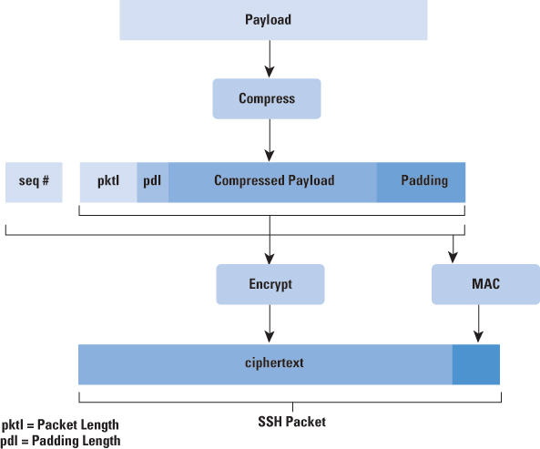
SSH: transport layer protocol
Binary packet protocol
p. <number>
Notes:
Process illustrating the calculation of encrypted packets.

Slide 17
SSH: transport layer protocol
Encryption algorithm
  Negotiated during key exchange
  Supported algorithms
    REQUIRED: 3des-cbc (“168” bit key)
    RECOMMENDED: aes128-cbc
    OPTIONAL: aes192-cbc, aes256-cbc,
    arcfour (i.e. RC4), etc.
  May be different for each direction
  Secret key established during key exchange
  All packets sent in 1 direction SHOULD be considered a single data stream
Supported encryption algorithms
3des-cbc* | Three-key Triple Digital Encryption Standard (3DES) in Cipher-Block-Chaining (CBC) mode
blowfish-cbc | Blowfish in CBC mode
twofish256-cbc | Twofish in CBC mode with a 256-bit key
twofish192-cbc | Twofish with a 192-bit key
twofish128-cbc | Twofish with a 128-bit key
aes256-cbc | Advanced Encryption Standard (AES) in CBC mode with a 256-bit key
aes192-cbc | AES with a 192-bit key
aes128-cbc** | AES with a 128-bit key
Serpent256-cbc | Serpent in CBC mode with a 256-bit key
Serpent192-cbc | Serpent with a 192-bit key
Serpent128-cbc | Serpent with a 128-bit key
arcfour | RC4 with a 128-bit key
cast128-cbc | CAST-128 in CBC mode
p. <number>

Slide 18
SSH: transport layer protocol
MAC algorithm
  Negotiated during key exchange
  Supported algorithms
    REQUIRED: hmac-sha1
    RECOMMENDED: hmac-sha1-96, hmac-sha2-256
      hmac-sha1-96: first 96 bits of hmac-sha1
    OPTIONAL: hmac-md5, hmac-md5-96,
    hmac-sha2-512, etc.
  May be different for each direction
  MAC = mac(key, seq. nr. | unencrypted packet)
    Implicit seq. nr. (4 bytes), not sent with packet
    Seq. nr. initialised to 0, incremented after each packet
Supported MAC algorithms
hmac-sha1* | HMAC-SHA1; Digest length = Key length = 20
hmac-sha1-96** | First 96 bits of HMAC-SHA1; Digest length = 12; Key length = 20
hmac-md5 | HMAC-SHA1; Digest length = Key length = 16
hmac-md5-96 | First 96 bits of HMAC-SHA1; Digest length = 12; Key length = 16
p. <number>
Notes:
The implicit sequence number for the MAC is never reset, not even if the keys and the algorithms for the SSH-connection are renegotiated later on.

Slide 19
SSH: transport layer protocol
New symmetric keys are generated and exchanged foe each new session
  Different keys for encryption and for MAC algorithms
  Can even support different keys for each direction
How are the symmetric keys exchanged?
  In a secure way?

Slide 20
SSH: transport layer protocol
Key exchange: shared session key
  Server sends
    Its shared session key
      Diffie Helman (see key exchange chapter)
    Its host (public) key
      For authentication
      Support for DSA, ECDSA, ED25519 or RSA
    A signature over (among other things)
      SSH_MSG_KEXINIT messages from both client and server (including cookies)
      DH public keys
      Host (public) key
p. <number>
Notes:
Key exchange happens in two fases: (i) first a shared key is generated using Diffie-Helman, (ii) afterwards the shared key is signed with the public key of the client to provide authentication.
For the creation and exchange of a symmetric key, Diffie Helman (DH) is used (see key exchange chapter). The way SSH uses DH is as an ephemeral algorithm: DH parameters are generated for individual sessions, and are destroyed as soon as they're no longer needed. The only thing the long-lasting key pair is used for is authentication. This gives forward secrecy: stealing the private key doesn't let you decrypt old sessions. This key agreement results in a shared session key.
In addition, after a shared key is established, the client host key is used to sign the Diffie-Hellman parameters. SSH protocol 2 supports signatures based on DSA, ECDSA, ED25519 or RSA signature algorithms. They are only used after key exchange to sign the DH messages and prove the client has the private key (one side of DH parameters being signed is enough to prevent a MITM, because the attacker can't impersonate both client and server; it's easier to make the server always have to have a keypair than make the client always have to have a keypair).
Now that the shared session key has been securely generated and authenticated, the rest of the session is encrypted using a symmetric cipher

Slide 21
SSH: transport layer protocol
Key exchange: server authentication
  Based on server host key
  Various possible techniques for key identification
    Using local databases
    Using certification authorities (CA) and certificates
    Using offline channels
      E.g. key “fingerprint”
    Using “best effort” approach
      Accept host key without check during first connection to the server
      Save host key in local database
      Check against saved key for later connections
  See alternatives from key exchange chapter
p. <number>

Slide 22
SSH: transport layer protocol
Key re-exchange
  Possible at any moment (except during key exchange)
  Can be initiated by either party
  Session ID doesn’t change
  Algorithms may be changed
  Session keys are changed
  Recommended
    After some amount of data (e.g. 1 GB)
    After some amount of time (e.g. 1 h)
p. <number>

Slide 23
SSH: User authentication protocol
SSH user authentication protocol
  Client authentication
  On top of SSH transport layer
3 authentication methods:
  Public key
  password
  Host based
p. <number>
Notes:
The User Authentication Protocol provides the means by which the client is authenticated to the server. Multiple authentication methods are supported. In case a password needs to be send, this can be done in a secure way since the underlying SSH transport layer already provides confidentiality and data-integrity.
Typically, the server will disconnect the client if the authentication has not been accepted within the timeout period (recommended value for the timeout: 10 minutes). Additionally, a limited number of failed authentication attempts is configured to prevent brute force attacks. The recommended value for the maximal number of failed authentication attempts is 20 within a single session.

Slide 24
SSH: User authentication protocol
client
server
SSH_MSG_USERAUTH_REQUEST
SSH_MSG_USERAUTH_FAILURE
(further authentication required)
SSH_MSG_USERAUTH_REQUEST
SSH_MSG_USERAUTH_FAILURE
(further authentication required)
SSH_MSG_USERAUTH_REQUEST
SSH_MSG_USERAUTH_SUCCESS
p. <number>
Notes:
The message exchange involves the following steps:
The client sends a SSH_MSG_USERAUTH_REQUEST with a requested method of none.
The server checks to determine if the username is valid. If not, the server returns SSH_MSG_USERAUTH_FAILURE with the partial success value of false. If the username is valid, the server proceeds to step 3.
The server returns SSH_MSG_USERAUTH_FAILURE with a list of one or more authentication methods to be used.
The client selects one of the acceptable authentication methods and sends a SSH_MSG_USERAUTH_REQUEST with that method name and the required method-specific fields. At this point, there may be a sequence of exchanges to perform the method.
If the authentication succeeds and more authentication methods are required, the server proceeds to step 3, using a partial success value of true. If the authentication fails, the server proceeds to step 3, using a partial success value of false.
When all required authentication methods succeed, the server sends a SSH_MSG_USERAUTH_SUCCESS message, and the Authentication Protocol is over.
The SSH_MSG_USERAUTH_REQUEST message contains the following fields: the user name, the service name, the method name, plus additional fields specific for the authentication method used. Username is the authorization identity the client is claiming, service name is the facility to which the client is requesting access (typically the SSH Connection Protocol), and method name is the authentication method being used in this request (“publickey”, “password” or “hostbased”).
If the server either rejects the authentication request or accepts the request but requires one or more additional authentication methods, the server sends a SSH_MSG_USERAUTH_FAILURE message. The SSH_MSG_USERAUTH_FAILURE message isn’t necessarily an indication of a fatally unsuccessful authentication. It may be merely an indication that the desired authentication isn’t yet achieved. This message contains a list of authentication methods that can continue and a partial success flag, which is set to TRUE if the previous request was successful but further authentication is needed, and is set to FALSE if the previous request failed. This implies that the number of SSH_MSG_USERAUTH_REQUEST and SSH_MSG_USERAUTH_FAILURE messages isn’t necessarily the same for all authentication processes.
Eventually, when the authentication is complete, the server replies with a SSH_MSG_USERAUTH_SUCCESS message and starts the requested service.

Slide 25
SSH: User authentication protocol
Authentication methods
  “Public key” method
    Supported by all implementations
    Client signs using his private key
    Server verifies signature and client’s public key
    Issue:
      Computationally expensive
      Few clients have public/private key pairs
  “Password” method
    Supported by all implementations
    Most widely used today
  “Host based” method
    Support is optional
    Authentication based on user’s host
    Client sends signature generated using client’s private host key
    Server verifies signature en client’s public host key
    Similar to “public key”
      Except for host authentication instead of user authentication
p. <number>
Notes:
The server may require one or more of the following authentication methods:
publickey: The details of this method depend on the public-key algorithm chosen. In essence, the client sends a message to the server that contains the client's public key, with the message signed by the client's private key. When the server receives this message, it checks to see whether the supplied key is acceptable for authentication and, if so, it checks to see whether the signature is correct. The SSH_MSG_USERAUTH_REQUEST may also contain a flag set to FALSE (instead of TRUE) and no signature. This allows the client to test whether this (computationally expensive) authentication method is accepted by the server. If it is, the server will respond with a SSH_MSG_USERAUTH_PK_OK message and the authentication can continue.
password: The client sends a message containing a plaintext password, which is protected by encryption by the Transport Layer Protocol. If the server answers with a SSH_MSG_USERAUTH_PASSWD_CHANGEREQ message, the client will change the password by sending a SSH_MSG_USERAUTH_REQUEST for the “password” method containing a TRUE (instead of FALSE) flag, the old password (in plaintext) and the new password (in plaintext).
Host based: Authentication is performed on the client's host rather than the client itself. Thus, a host that supports multiple clients would provide authentication for all its clients. This method works by having the client send a signature created with the private key of the client host. Thus, rather than directly verifying the user's identity, the SSH server verifies the identity of the client host—and then believes the host when it says the user has already authenticated on the client side.

Slide 26
SSH: connection protocol
SSH connection protocol
  Multiplexes secure tunnel provided by SSH transport layer and user authentication layer into several logical channels
  Logical channels can be used for various purposes
p. <number>
Notes:
The SSH Connection Protocol runs on top of the SSH Transport Layer Protocol and assumes that a secure authentication connection is in use. That secure authentication connection, referred to as a tunnel, is used by the Connection Protocol to multiplex a number of logical channels.
Confusingly, RFC 4254, "The Secure Shell (SSH) Connection Protocol," states that the Connection Protocol runs on top of the Transport Layer Protocol whilst the User Authentication Protocol RFC 4251, "SSH Protocol Architecture," states that the Connection Protocol runs over the User Authentication Protocol. In fact, the Connection Protocol runs over the Transport Layer Protocol, but assumes that the User Authentication Protocol has been previously invoked.

Slide 27
SSH: connection protocol
Applications implemented as “channels”
  All channels are multiplexed into single encrypted tunnel (provided by SSH transport layer protocol)
  Channels identified by channel numbers at both ends of the connection
  Channel numbers may differ for same channel at client and server sides
Example channels
  Session (shell, file transfer, e-mail, system command, ...)
  X11-connections
  Local port forwarding (direct TCP/IP)
  Remote port forwarding (forwarded TCP/IP)
p. <number>
Notes:
All types of communication using SSH, such as a terminal session, are supported using separate channels. Either side may open a channel. For each channel, each side associates a unique channel number, which need not be the same on both ends. Channels are flow-controlled using a window mechanism. No data may be sent to a channel until a message is received to indicate that window space is available.
Four channel types are recognized in the SSH Connection Protocol specification:
session: Session refers to the remote execution of a program. The program may be a shell, an application such as file transfer or e-mail, a system command, or some built-in subsystem. When a session channel is opened, subsequent requests are used to start the remote program.
x11: This channel type refers to the X Window System, a computer software system and network protocol that provides a GUI for networked computers. X allows applications to run on a network server but be displayed on a desktop machine.
direct-tcpip: This channel type is local port forwarding, as explained subsequently.
forwarded-tcpip: This channel type is remote port forwarding, as explained subsequently.

Slide 28
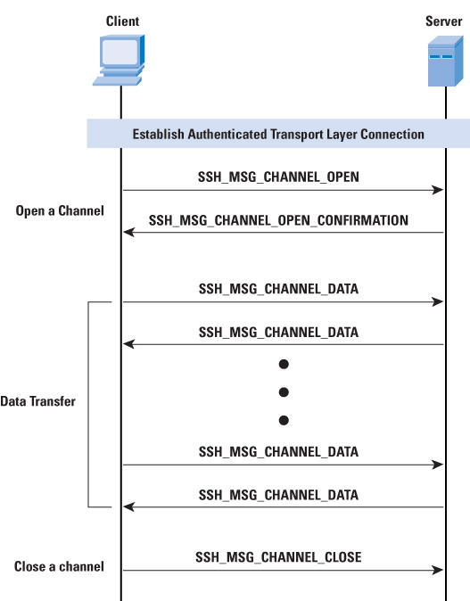
SSH: connection protocol
Opening a channel
p. <number>
Notes:
The life of a channel progresses through three stages: opening a channel, data transfer, and closing a channel.
When either side wishes to open a new channel, it allocates a local number for the channel and then sends a message containing the channel type, sender channel, initial window size and maximum packet size. The channel type identifies the application for this channel, as described previously. The sender channel is the local channel number. The initial window size specifies how many bytes of channel data can be sent to the sender of this message without adjusting the window. The maximum packet size specifies the maximum size of an individual data packet that can be sent to the sender. For example, one might want to use smaller packets for interactive connections to get better interactive response on slow links.
If the remote side is able to open the channel, it returns a SSH_MSG_CHANNEL_OPEN_CONFIRMATION message, which includes the sender channel number, the recipient channel number, and window and packet size values for incoming traffic. Otherwise, the remote side returns a SSH_MSG_CHANNEL_OPEN_FAILURE message with a reason code indicating the reason for failure.
After a channel is open, data transfer is performed using a SSH_MSG_CHANNEL_DATA message, which includes the recipient channel number and a block of data. These messages, in both directions, may continue as long as the channel is open.
When either side wishes to close a channel, is sends a SSH_MSG_CHANNEL_CLOSE message, which includes the recipient channel number.

Slide 29
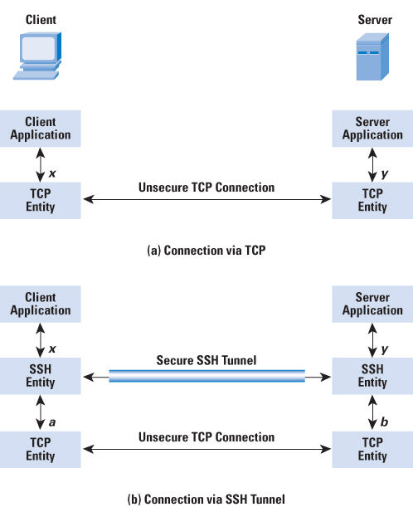
SSH: connection protocol
SSH port forwarding
  Goals
    Transform insecure TCP to secure SSH connections
      “SSH tunnel”
    Bypass network restrictions
  Local and remote port forwarding
p. <number>
Notes:
One of the most useful features of SSH is port forwarding. Port forwarding or port mapping is an application of network address translation (NAT) that redirects a communication request from one address and port number combination to another while the packets are traversing a network gateway. SSH port forwarding provides the ability to convert any insecure TCP connection into a secure SSH connection. It is also referred to as SSH tunneling. We need to know what a port is in this context. A port is an identifier of a user of TCP. So, any application that runs on top of TCP has a port number. Incoming TCP traffic is delivered to the appropriate application on the basis of the port number. For example, for the Simple Mail Transfer Protocol (SMTP), the server side generally listens on port 25, so that an incoming SMTP request uses TCP and addresses the data to destination port 25. TCP recognizes that this address is the SMTP server address and routes the data to the SMTP server application. The figure illustrates the basic concept behind port forwarding. We have a client application that is identified by port number x and a server application identified by port number y. At some point, the client application invokes the local TCP entity and requests a connection to the remote server on port y. The local TCP entity negotiates a TCP connection with the remote TCP entity, such that the connection links local port x to remote port y. To secure this connection, SSH is configured so that the SSH Transport Layer Protocol establishes a TCP connection between the SSH client and server entities with TCP port numbers a and b, respectively. A secure SSH tunnel is established over this TCP connection. Traffic from the client at port x is redirected to the local SSH entity and travels through the tunnel where the remote SSH entity delivers the data to the server application on port y. Traffic in the other direction is similarly redirected.
SSH supports two types of port forwarding: local forwarding and remote forwarding.
Local forwarding is used to forward data securely from another client application running on the same computer (using different port numbers) as the Secure Shell Client. It is frequently used to (i) transform an insecure TCP connection by a secure one and/or (ii) to bypass network restrictions. Local port forwarding allows the client to set up a "hijacker" process. This process will intercept selected application-level traffic and redirect it from an unsecured TCP connection to a secure SSH tunnel. SSH is configured to listen on selected ports, grabs all traffic that uses the selected port and sends it through an SSH tunnel. On the other end, the SSH server sends the incoming traffic to the destination port dictated by the client application. Local port forwarding is the most common type of port forwarding.
With remote forwarding, the user's SSH client acts on the server's behalf. The client receives traffic with a given destination port number, places the traffic on the correct port, and sends it to the destination the user chooses. Remote port forwarding allows other computers to access applications hosted on remote servers. This form of port forwarding enables applications on the server side of a Secure Shell (SSH) connection to access services residing on the SSH's client side. With remote forwarding, the user's SSH client acts on the server's behalf. The client receives traffic with a given destination port number, places the traffic on the correct port, and sends it to the destination the user chooses. A typical example of remote forwarding follows: You wish to access a server at work from your home computer. Because the work server is behind a firewall, it will not accept an SSH request from your home computer. However, from work you can set up an SSH tunnel using remote forwarding.

Slide 30
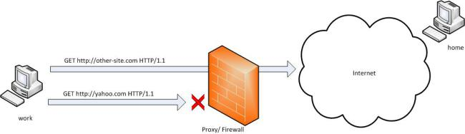
SSH: connection protocol
Local Port Forwarding (outgoing tunnel)
  Example: create an outgoing tunnel passing a firewall
p. <number>
Notes:
Let’s say that yahoo.com is being blocked using a proxy filter in the University. A SSH tunnel can be used to bypass this restriction.

Slide 31
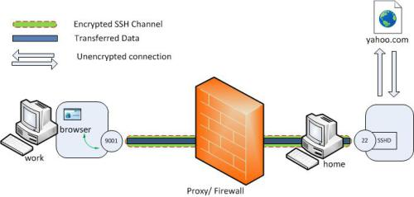
SSH: connection protocol
Local Port Forwarding (outgoing tunnel)
  The remote host (server) acts as a gateway
    Example: create an outgoing tunnel passing a firewall
  Command:
    ssh -L local_port:remote_host:remote_port login@servername
    ssh -L 9001:yahoo.com:80 home
p. <number>
Notes:
The syntax of the local port forwarding command is as follows (The ‘L’ switch indicates that a local port forward is need to be created):
ssh -L <local-port-to-listen>:<remote-host>:<remote-port> <servername>
It can be interpreted as: I want to securely connect to <remote port> on <remote host> and to this end I set up an SSH tunnel from <local port> at my current host to <servername> (which will act as a gateway).
Let’s name my machine at the university as ‘work’ and my home machine as ‘home’ (‘home’ needs to have a public IP for this to work). I am running an SSH server on my home machine. To create the SSH tunnel execute the following from the ‘work’ machine.
ssh -L 9001:yahoo.com:80 home
Now the SSH client at ‘work’ will connect to the SSH server running at ‘home’ (usually running at port 22) binding port 9001 of ‘work’ to listen for local requests thereby creating a SSH tunnel between ‘home’ and ‘work’. At the ‘home’ end it will create a connection to ‘yahoo.com’ at port 80. So ‘work’ doesn’t need to know how to connect to yahoo.com. Only ‘home’ needs to worry about that. Now it is possible to browse to yahoo.com by visiting http://localhost:9001 in the web browser at the ‘work’ computer. The ‘home’ computer will act as a gateway which would accept requests from ‘work’ machine and fetch data to tunnel it back. The connection from ‘host’ to ‘yahoo.com’ is only made when the browser makes the request (i.e. not already during the tunnel setup). The channel between ‘work’ and ‘home’ will be encrypted while the connection between ‘home’ and ‘yahoo.com’ will be unencrypted.
It is also possible to specify a port belonging to the ‘home’ computer itself instead of connecting to an external host. This option is typically not used if gateway functionality is required (i.e.: not for passing a firewall), but if an unsecure connection needs to be replaced by a secure connection. Typical use cases include using SSH to securely retrieve (port 110, POP) or transmit (port 25, SMTP) e-mails. For example, when setting up a VNC session between ‘work’ and ‘home’, the command line would be as follows.
ssh -L 5900:localhost:5900 home (executed from 'work')
So what does localhost refer to? Is it the ‘work’ since the command line is executed from ‘work’? Turns out that it is not: the localhost is considered relative to the gateway (‘home’ in this case) , not the machine from where the tunnel is initiated. So this will make a connection to port 5900 of the ‘home’ computer where the VNC client would be listening in. As such, the command is equivalent to
ssh -L 5900:home:5900 home (executed from 'work')
This last notation makes the fact that in this case the server (‘work’) does not act as a gateway more explicit.

Slide 32
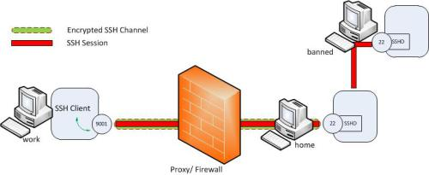
SSH: connection protocol
Local Port Forwarding (outgoing tunnel)
  Example: tunnelling of SSH sessions
    ssh -L 9001:banned:22 home
    ssh -p 9001 localhost
p. <number>
Notes:
The created tunnel can be used to transfer any type of connection and is thus not limited to web browsing sessions. In addition to mail sessions, ftp sessions, etc., we can even tunnel SSH sessions. Let’s assume there is another computer (‘banned’) to which we need to SSH from within University but the SSH access is being blocked. It is possible to tunnel a SSH session to this host using a local port forward.
As can be seen now the transferred data between ‘work’ and ‘banned’ are encrypted end to end. For this we need to create a local port forward from the work PC as follows.
ssh -L 9001:banned:22 home (executed from 'work')
Now ‘home’ acts as a gateway for tunneling SSH sessions to ‘banned’.
To connect over SSH with ‘banned’, we now create an SSH session to local port 9001 from the work PC.
ssh -p 9001 localhost
This new SSH session will automatically get tunneled to ‘banned’ via the ‘home’ gateway due to the previously configured port forwarding rules.

Slide 33
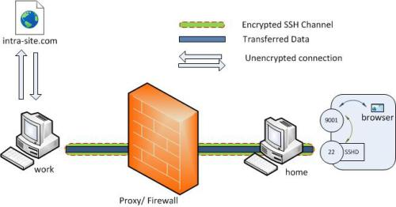
SSH: connection protocol
Remote Port Forwarding (incoming or reverse tunnel)
  The local host (client) acts as a gateway
    Example: firewall blocking all traffic
  Command:
    ssh -R remote_port:local_host:local_port login@servername
    ssh -R 9001:intra-site.com:80 home
p. <number>
Notes:
The syntax of the remote port forwarding command is as follows (The ‘R’ switch indicates that a remote port forward is created):
ssh -R <server-port> :<remote-host>:<remote-port> <server name>
The command can be interpreted as: I will act as a gateway to forward connections from <server port> on <server name> to <remote-port> on <remote-host> using a secure SSH tunnel.
Let’s say we want to connect to an internal company intranet from home, but the work firewall is blocking all incoming traffic. How can we connect from ‘home’ to the internal network so that we can browse the internal site? (A VPN setup is a good candidate here, but however for this example let’s assume we don’t have this facility). As discussed, local port forwarding creates an outgoing tunnel and as such is not useful in this case. However, we can use remote port forwarding (also referred to as SSH reverse tunneling) to create an incoming tunnel. As before, we will initiate the tunnel from the ‘work’ computer behind the firewall. This is possible since only incoming traffic is blocked and outgoing traffic is allowed. However instead of the earlier case the client will now be at the ‘home’ computer.
ssh -R 9001:intra-site.com:80 home (executed from 'work‘, note the R instead of L)
Once executed the SSH client (‘work’) will connect to the SSH server (running at home) to create an SSH channel. Then the server will bind port 9001 on the ‘home’ machine to listen for incoming requests which would subsequently be routed through the created SSH channel between ‘home’ and ‘work’. Now it’s possible to browse the internal site by visiting http://localhost:9001 in ‘home’ web browser. The ‘work’ SSH server will then create a connection to the intra-site and relay back the response to ‘home’ via the created SSH channel.
As such, the command is very similar to the local port forwarding command, but the SSH client (work) acts as a gateway for incoming traffic rather than the SSH server (home). The main advantage is that in this case the creation of the tunnel was initiated from the gateway, allowing it to bypass NAS or firewall restrictions.

Slide 34
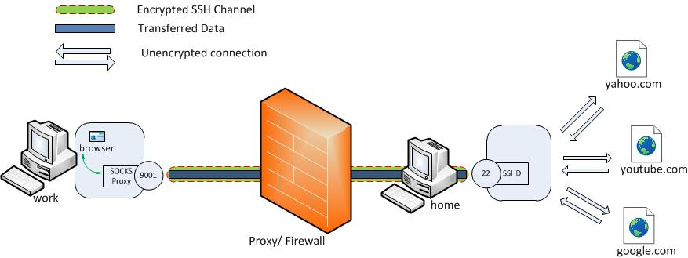
SSH: connection protocol
Dynamic Port Forwarding
  SOCKS proxy
  Command
    ssh -D 9001 home
p. <number>
Notes:
Although useful, local and remote port forwarding require the creation of yet another tunnel if you need to connect to another website. Dynamic port forwarding makes it possible to proxy traffic to any site using the SSH created channel.
Dynamic port forwarding allows to configure one local port for tunneling data to all remote destinations. However to utilize this the client application connecting to local port should send their traffic using the SOCKS protocol. At the client side of the tunnel a SOCKS proxy would be created and the application (eg. browser) uses the SOCKS protocol to specify where the traffic should be sent when it leaves the other end of the ssh tunnel.
ssh -D 9001 home (executed from 'work')
Here SSH will create a SOCKS proxy listening in for connections at local port 9001 and upon receiving a request would route the traffic via SSH channel created between ‘work’ and ‘home’. It is required to configure the browser to point to the SOCKS proxy at port 9001 at localhost.

Slide 35
SSH: best practices
Disable weak passwords
Only use SSH2
Restrict root access
Etc.
Examples at
  http://www.ibm.com/developerworks/aix/library/au-sshsecurity/
Notes:
Many good systems administrators are nervous about security. Here is a list of processes and configurations that you can use to tighten and enhance SSH security with regard to remote host access.
Restrict the root account to console access only:
# vi /etc/ssh/sshd_config
PermitRootLogin no
Create private-public key pairs using a strong passphrase and password protection for the private key (never generate a password-less key pair or a password-less passphrase key-less login):
ssh-keygen -t rsa -b 4096 (Use a higher bit rate for the encryption for more security)
Only use SSH Protocol 2:
# vi /etc/ssh/sshd_config
Protocol 2
Restrict the available interfaces that SSH will listen on and bind to:
# vi /etc/ssh/sshd_config
ListenAddress 192.168.100.17
ListenAddress 209.64.100.15
Set user policy to enforce strong passwords to protect against brute force, social engineering attempts, and dictionary attacks:
# < /dev/urandom tr -dc A-Za-z0-9_ | head -c8
oP0FNAUt[
Confine SFTP users to their own home directories by using Chroot SSHD:
# vi /etc/ssh/sshd_config ChrootDirectory /data01/home/%u
X11Forwarding no
AllowTcpForwarding no
Disable empty passwords:
# vi /etc/ssh/sshd_config
PermitEmptyPasswords no
Always keep the SSH packages and required libraries up to date on patches:
# yum update openssh-server openssh openssh-clients –y
SSH supports numerous, diverse methods and techniques for authentication that you can enable or disable. Within the /etc/ssh/sshd_config file, you make these configurations changes by entering the keyword listed for the authentication method followed by yes or no. Here are some of the common configuration changes:
# RSAAuthentication yes
# PubkeyAuthentication yes
# RhostsRSAAuthentication no
# HostbasedAuthentication no
# RhostsRSAAuthentication and HostbasedAuthentication PasswordAuthentication yes ChallengeResponseAuthentication no
# KerberosAuthentication no GSSAPIAuthentication yes

Slide 36
SSH: alternatives
SSH shortcomings
  Not designed for slow connections
    lagging SSH console session.
  Not designed for connection drops
    SSH state connection is lost
  SSH works over TCP
    No IP address roaming supported.
  Not designed for large network latencies and round trip times
Alternative: MOSH (Mobile Shell)
  Designed for mobile devices and unreliable connections

Slide 37
Test yourself
True or false: the SSH transport layer protocol encrypts TCP packets. Explain.
Explain the functions of the SSH transport layer protocol, SSH user authentication protocol and SSH connection protocol
In which scenarios does it make sense to do a SSH key re-exchange? Why?
What is the difference between a SSH session and a SSH channel? Which channels are supported?
Which port number does SSH typically listen to?
Explain the difference between local and remote port forwarding.

